Slide 1

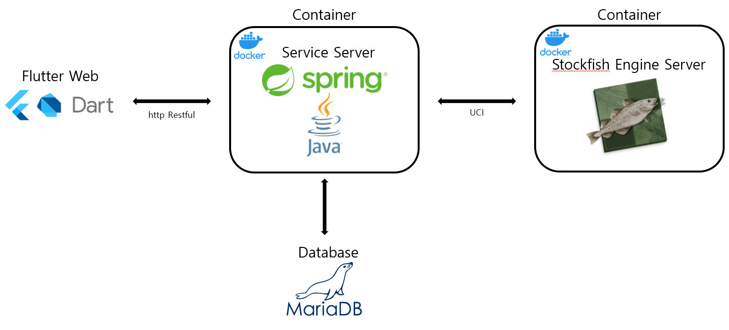


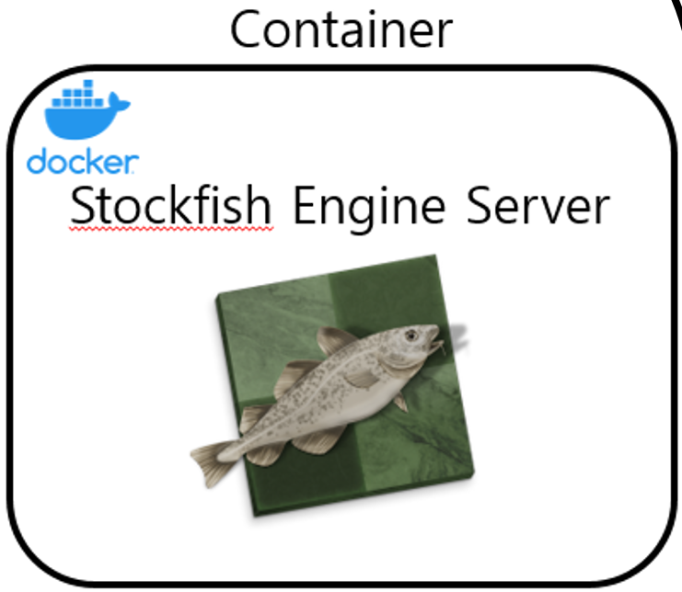

Container
Stockfish Control Server
gRPC
UCI
StockFish

Slide 2
StockFish

